Slide 1


Slide 2
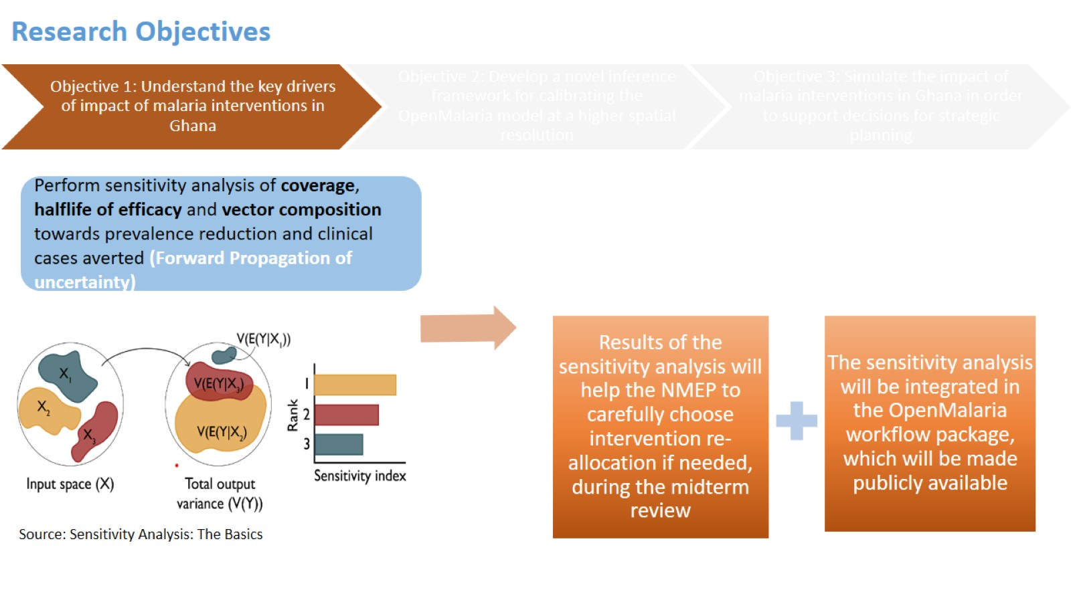
Research Objectives

Slide 3
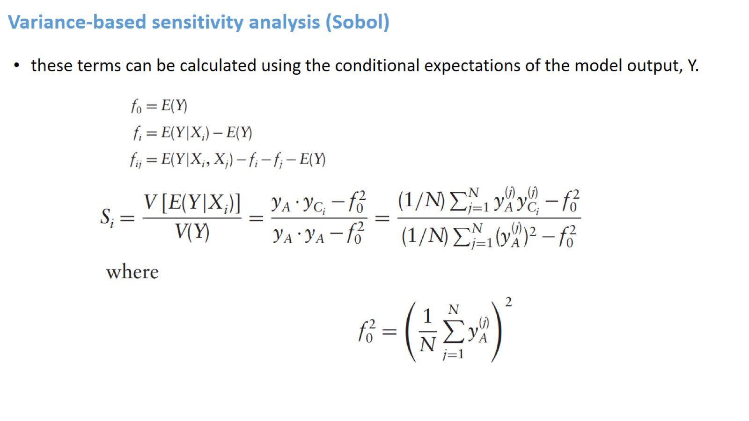
Variance-based sensitivity analysis (Sobol)

Slide 4
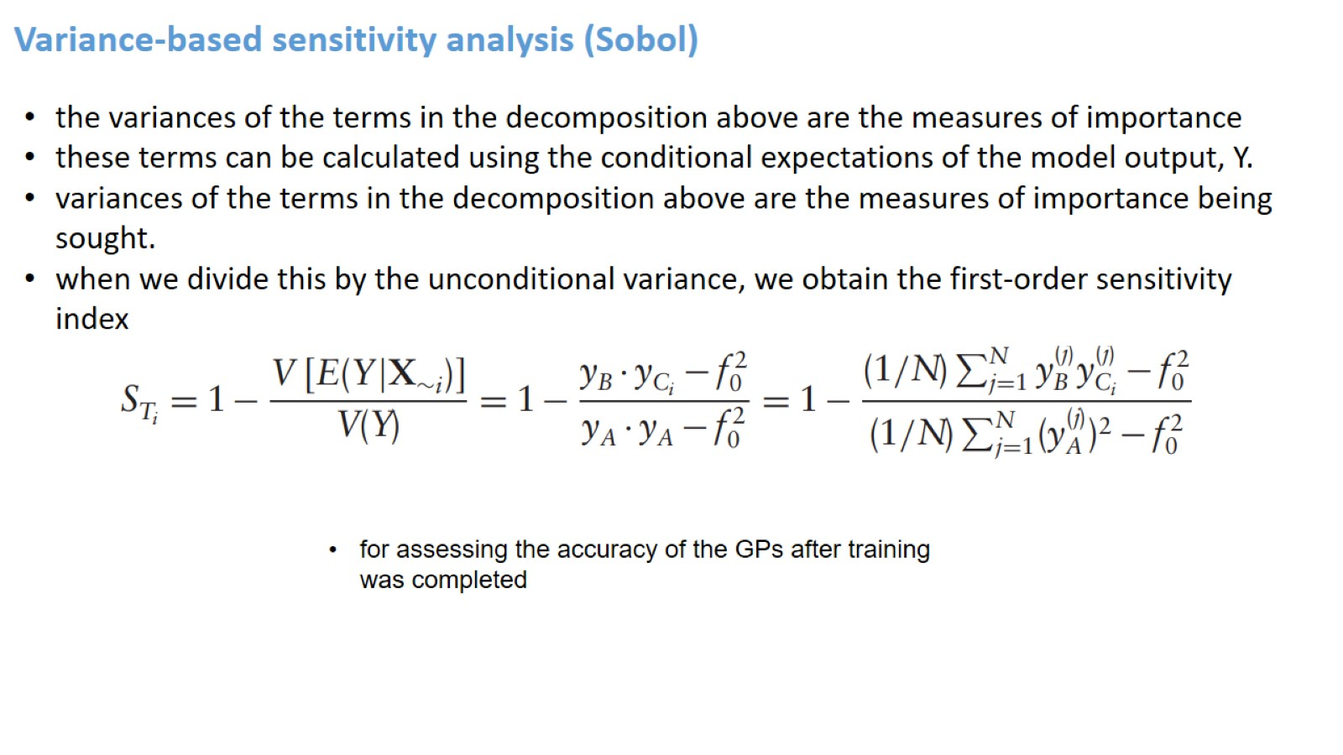
Variance-based sensitivity analysis (Sobol)

Slide 5
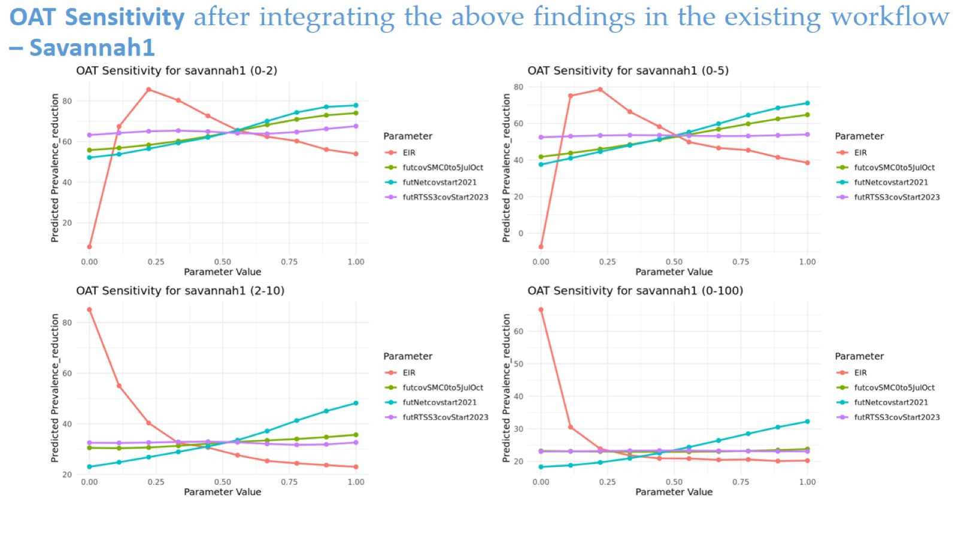
OAT Sensitivity after integrating the above findings in the existing workflow – Savannah1

Slide 6
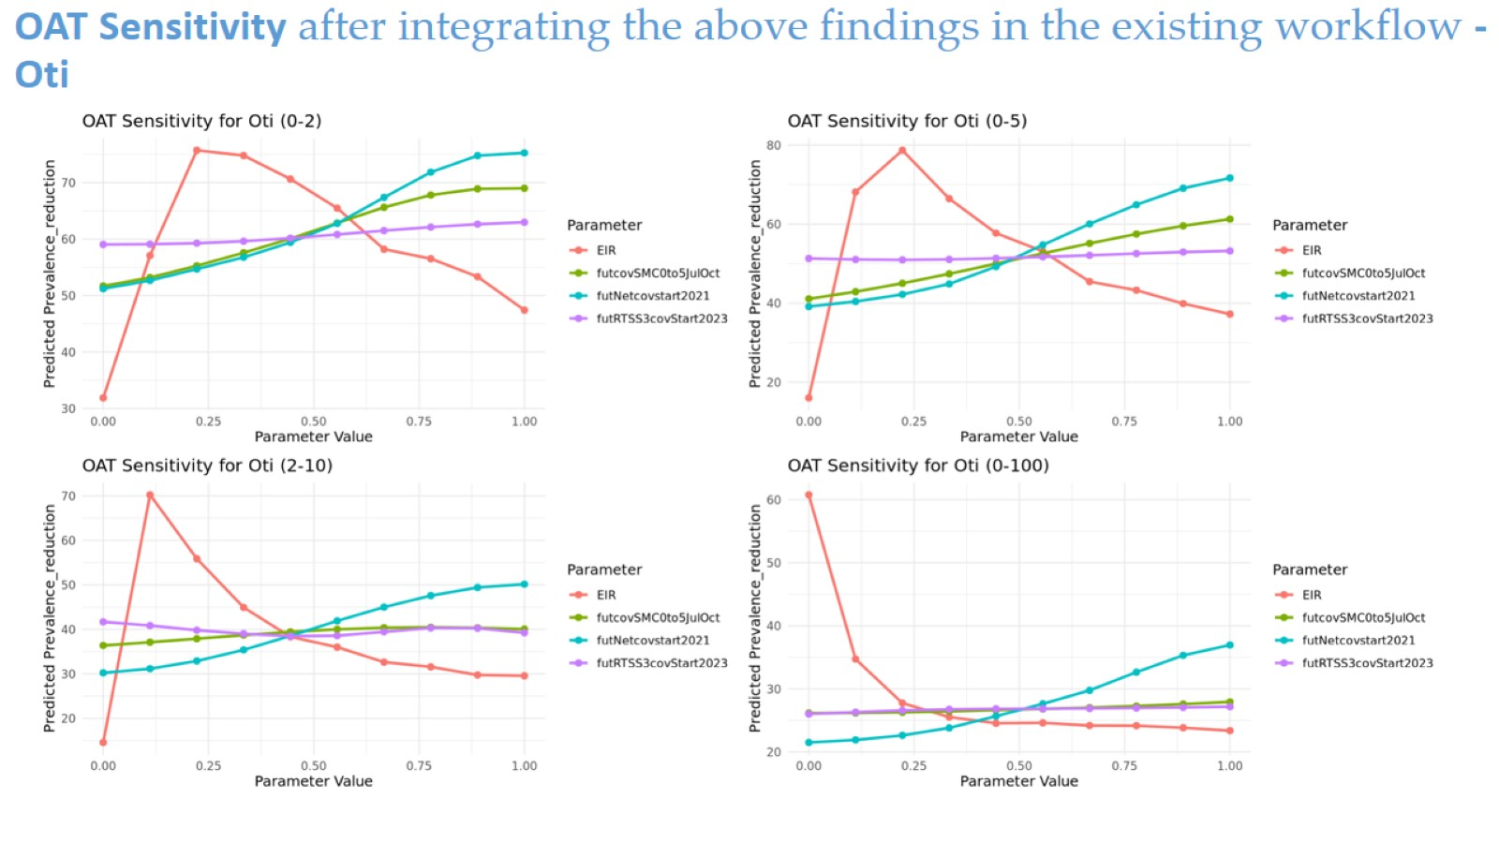
OAT Sensitivity after integrating the above findings in the existing workflow - Oti

Slide 7
